Slide 1
Θεωρητική Πληροφορική
Κυρτό Περίβλημα
(Convex Hull Problem)
Κεμετζής Γεώργιος
Κρητικός Απόστολος

Slide 2
Ορισμός
Κυρτό περίβλημα (convex hull) ενός συνόλου σημείων S σε κάποιον χώρο λέγεται το ελάχιστο κυρτό πολύγωνο που περικλείει όλα ανεξαιρέτως τα σημεία, είτε στο εσωτερικό του είτε στην περιφέρειά του.
Ο όρος ελάχιστο σημαίνει πως το convex hull του συνόλου S θα πρέπει να είναι υποσύνολο κάθε άλλου κυρτού πολυγώνου που περιέχει το S.

Slide 3
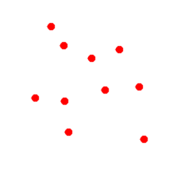
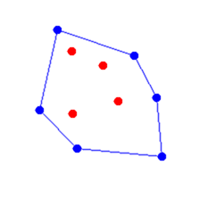

Slide 4
Αλγόριθμοι επίλυσης
Brute force
Divide and Conquer (QuickHull)
Jarvis March (Gift Wrapping)
Graham scan
Akl-Toussaint heuristics

Slide 5
Brute Force
Complexity: O(n³)
for each point Pi
for each point Pj where Pj ≠ Pi
Compute the line segment for Pi and Pj
[
Pi(x₁,y₁), Pj (x₂,y₂)
ax + by = c
a = y₂ – y₁
b = x₁ – x₂
c = x₁y₂ – x₂y₁
]
for every other point Pk where Pk ≠ Pi and Pk ≠ Pj
If each Pk(x_{k},y_{k}) is on one side of the line segment,
[
ax_{k} + by_{k} – c must have the same sign for eack Pk
]
then label Pi and Pj in the convex hull

Slide 6
Divide & Conquer (QuickHull) I
Input = a set S of n points
Assume that there are at least 2 points in the input set S of points
QuickHull (S)
{
// Find convex hull from the set S of n points
Convex Hull := {}
Find left and right most points, say A & B, and add A & B to convex hull
Segment AB divides the remaining (n-2) points into 2 groups S1 and S2
where S1 are points in S that are on the right side of the oriented line
from A to B, and S2 are points in S that are on the right side of the oriented line
from B to A
FindHull (S1, A, B)
FindHull (S2, B, A)
}

Slide 7
Divide & Conquer (QuickHull) II
FindHull (Sk, P, Q)
{
// Find points on convex hull from the set Sk of points
// that are on the right side of the oriented line from P to Q
If Sk has no point,
then return.
From the given set of points in Sk, find farthest point, say C, from segment PQ
Add point C to convex hull at the location between P and Q
Three points P, Q, and C partition the remaining points of Sk into 3 subsets: S0, S1,
and S2 where S0 are points inside triangle PCQ, S1are points on the right side
of the oriented line from P to C, and S2 are points on the right side of the oriented line
from C to Q.
FindHull(S1, P, C)
FindHull(S2, C, Q)
}
Output = convex hull

Slide 8
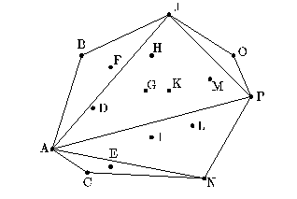
Divide & Conquer (QuickHull) III
Average: Θ(nlogn)
Worst: Θ(n²)

Slide 9
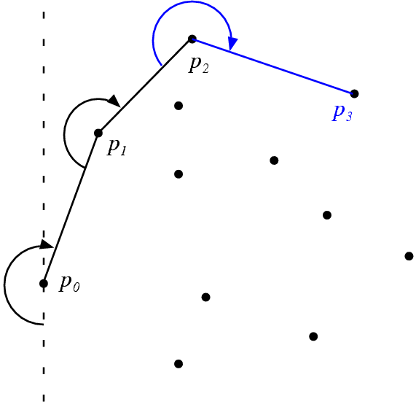
Jarvis March (Gift Wrapping) I
jarvis(P)
i = 0
p[0] = leftmost point of P
do
p[i+1] = point such that all other points in P are to the
right of the line p[i]p[i+1]
i = i + 1
while p[i] != p[0]
return p
Complexity: O(nh)
n: set of the plane points
h: set of the convex hull points

Slide 10


